Slide 1





PRESENTATION 2026
Faculty Name
Faculty Email
Ms.S.MALLIKA
smallika5789@gmail.com
Mentor Name
Ms,Uma Maheswari R

Slide 2

Outline
Abstract of the Project
Problem Statement
Proposed Solution
System Architecture
Live Demo of the Project
Embedded Video of Project
Conclusion
Future Scope

Slide 3
Abstract
This project, developed under the AICW Fellowship Program supported by Edunet Foundation with Microsoft, LinkedIn, and SAP, focuses on using Artificial Intelligence and data analytics to enhance student feedback analysis. Traditional systems rely mainly on numerical ratings and often miss insights from qualitative comments. The Student Feedback & Teaching Improvement Analyzer uses sentiment analysis and visualization techniques to evaluate teaching quality and course effectiveness across key parameters like communication, interaction, and practical knowledge. The system provides clear insights through dashboards, helping faculty and administrators make data-driven decisions. This project demonstrates how AI can transform feedback into actionable recommendations, supporting continuous improvement in education..

Slide 4

Problem Statement
Educational institutions rely on student feedback to evaluate teaching quality
Feedback data is often large and unstructured
Difficult to extract meaningful insights
Lack of proper tools for analysis and visualization
Key Challenges
Unstructured and qualitative feedback
Limited analytical capabilities
No standardized evaluation system
Lack of interactive dashboards

Slide 5

Proposed Solution
Develop an AI-based system to analyze student feedback for teaching improvement
Collect both quantitative data (ratings) and qualitative data (comments)
Use sentiment analysis to understand student opinions and emotions
Apply data analytics and statistical modeling to evaluate teaching effectiveness
Transform unstructured feedback into clear, actionable insights
Identify strengths and weaknesses in teaching methods and course delivery
Detect patterns and trends over time for continuous performance monitoring
Provide a decision support system for faculty and administrators
Integrate interactive visualizations (charts, dashboards) for easy interpretation
Enable data-driven decision-making in educational institutions
Support continuous improvement in teaching strategies
Enhance student learning outcomes and overall academic quality

Slide 6
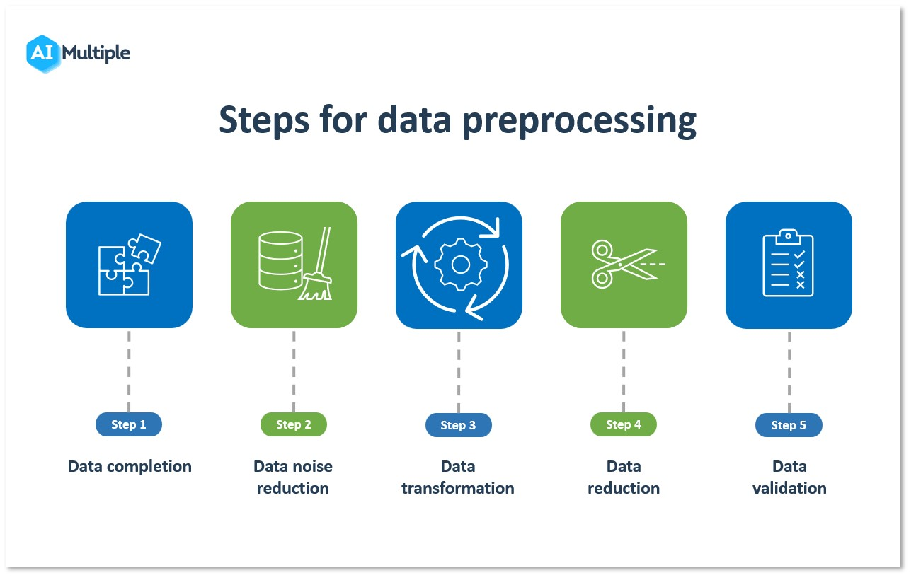
System Architecture
Data Input / Source

Slide 7
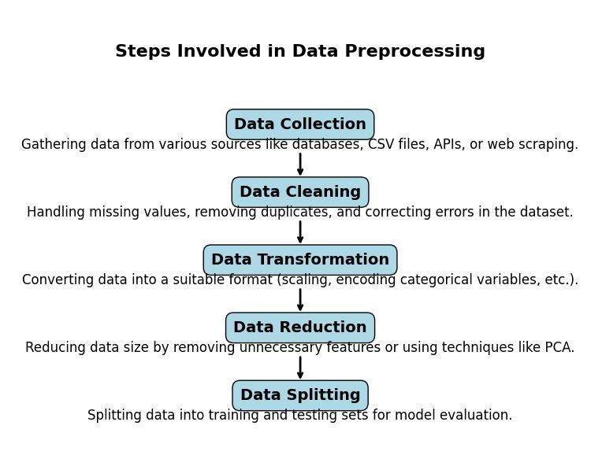
System Architecture
Processing / Analysis

Slide 8
System Architecture
AI / Tool Integration
Excel is used for data storage, cleaning, and preprocessing
Power BI is used to create interactive dashboards and visualizations
AI tools / Copilot are used for generating insights and summarizing feedback
Integration of tools enables automated analysis and real-time insights

Slide 9
System Architecture
Output / Dashboard

Slide 10
Video of Project Demo
[https://your-project-demo-link.com]
▶
[Insert your project demo video.
You can embed a video your live project.]

Slide 11
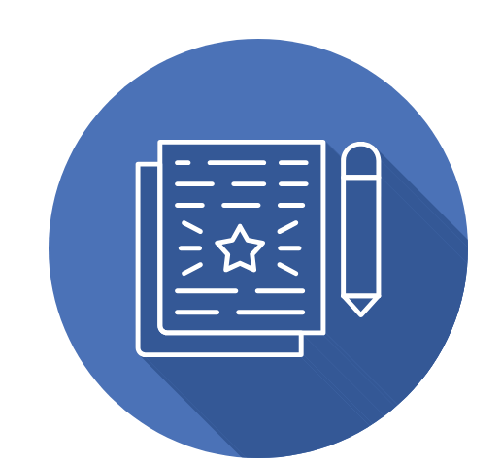
Conclusion
This project demonstrated the value of applying educational analytics to student feedback by systematically cleaning data, analyzing sentiment, and visualizing course and faculty performance. Through the use of tools such as Excel, Power BI, and AI Copilot, raw feedback was transformed into reliable datasets and actionable insights. The findings revealed that while overall student sentiment was largely positive, a significant proportion expressed concerns about clarity, pace, and interaction, highlighting areas for improvement. Course-level analysis showed that HRM and Banking achieved the highest ratings, whereas Business Management required focused attention. Faculty ratings also varied, with Priya receiving the strongest score and Ravi showing the greatest need for support. Importantly, AI-assisted prompts reduced reporting time and ensured reproducibility, making the workflow efficient and scalable. Overall, the project underscores the importance of data-driven decision-making in education, providing a roadmap for enhancing teaching effectiveness, improving student engagement, and fostering continuous academic development.
CONCLUSION

Slide 12

Future Scope
The project can be further enhanced by integrating advanced technologies and expanding its capabilities. Real-time data pipelines can be implemented using tools like Power Automate or APIs to enable continuous feedback updates. Machine learning models such as forecasting and anomaly detection can be applied to generate predictive insights.
Additionally, developing a user-friendly web or Power Apps interface will improve accessibility for non-technical users. The system can be expanded by incorporating diverse datasets such as multi-semester feedback, attendance, and academic performance for deeper analysis.
Further improvements include building a standardized AI prompt library for consistent analysis and applying advanced NLP techniques to better understand complex sentiments. Long-term performance tracking across academic cycles can also be introduced to identify trends and support continuous improvement in teaching and learning outcomes.

Slide 13
Thank You
AICW Fellowship | Student Project Presentation 2026
LinkedIn | Edunet Foundation

